Slide 1



Imputation workshop
Yu Wang (Postdoctoral Scientist Quantitative Genetics & Genomics)
yu.wang@lic.co.nz

Slide 2

Today's Agenda
Welcome
to the workshop!
9:00-9:30 Test NeSI & Greeting
9:30-10:30 Imputation introduction (Dr. Yu Wang)
10:30-11:00 Coffee break
11:00-12:00 Imputation application (Dr. Andrew Wallace)
12:00-13:00 Lunch break
13:00-15:30 Tutorial
15:30-16:00 Wrap up

Slide 3

Self intro & What species you are working on
Human
Plants
Animals
Microbioms
Others

Slide 4
Content
What is imputation
Why we need imputation
Phasing
How to evaluate the imputation accuracy

Slide 5
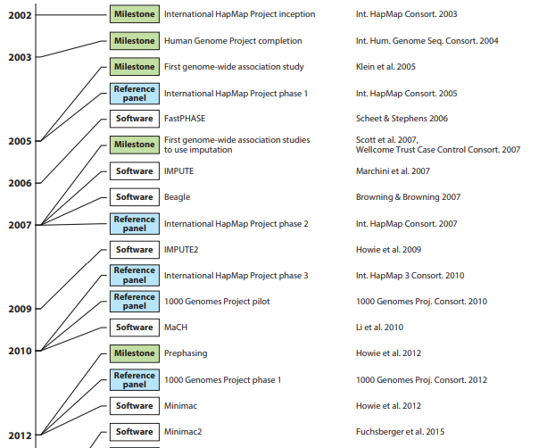
Annu. Rev. Genom. Hum. Genet. 2018. 19:73–96

Slide 6
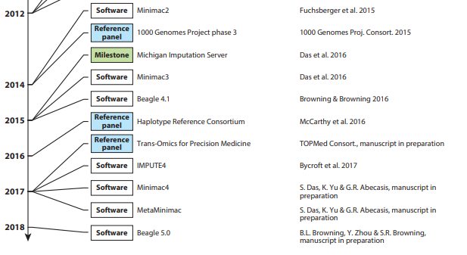
Annu. Rev. Genom. Hum. Genet. 2018. 19:73–96

Slide 7

What is imputation

Slide 8
Imputation describes the process of predicting genotypes that have not been directly typed in a sample of individuals:
missing genotypes at typed variants
genotypes at un-typed variants that are present in an external high-density "reference panel" of phased haplotypes
In silico genotypes can be tested for association within standard generalised linear regression framework
https://en.wikipedia.org/wiki/Imputation_(genetics)

Slide 9
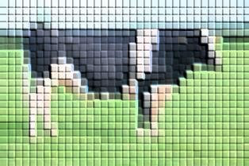
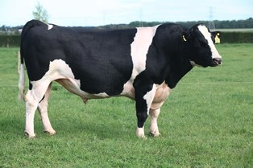
low density panel
high density panel

Slide 10
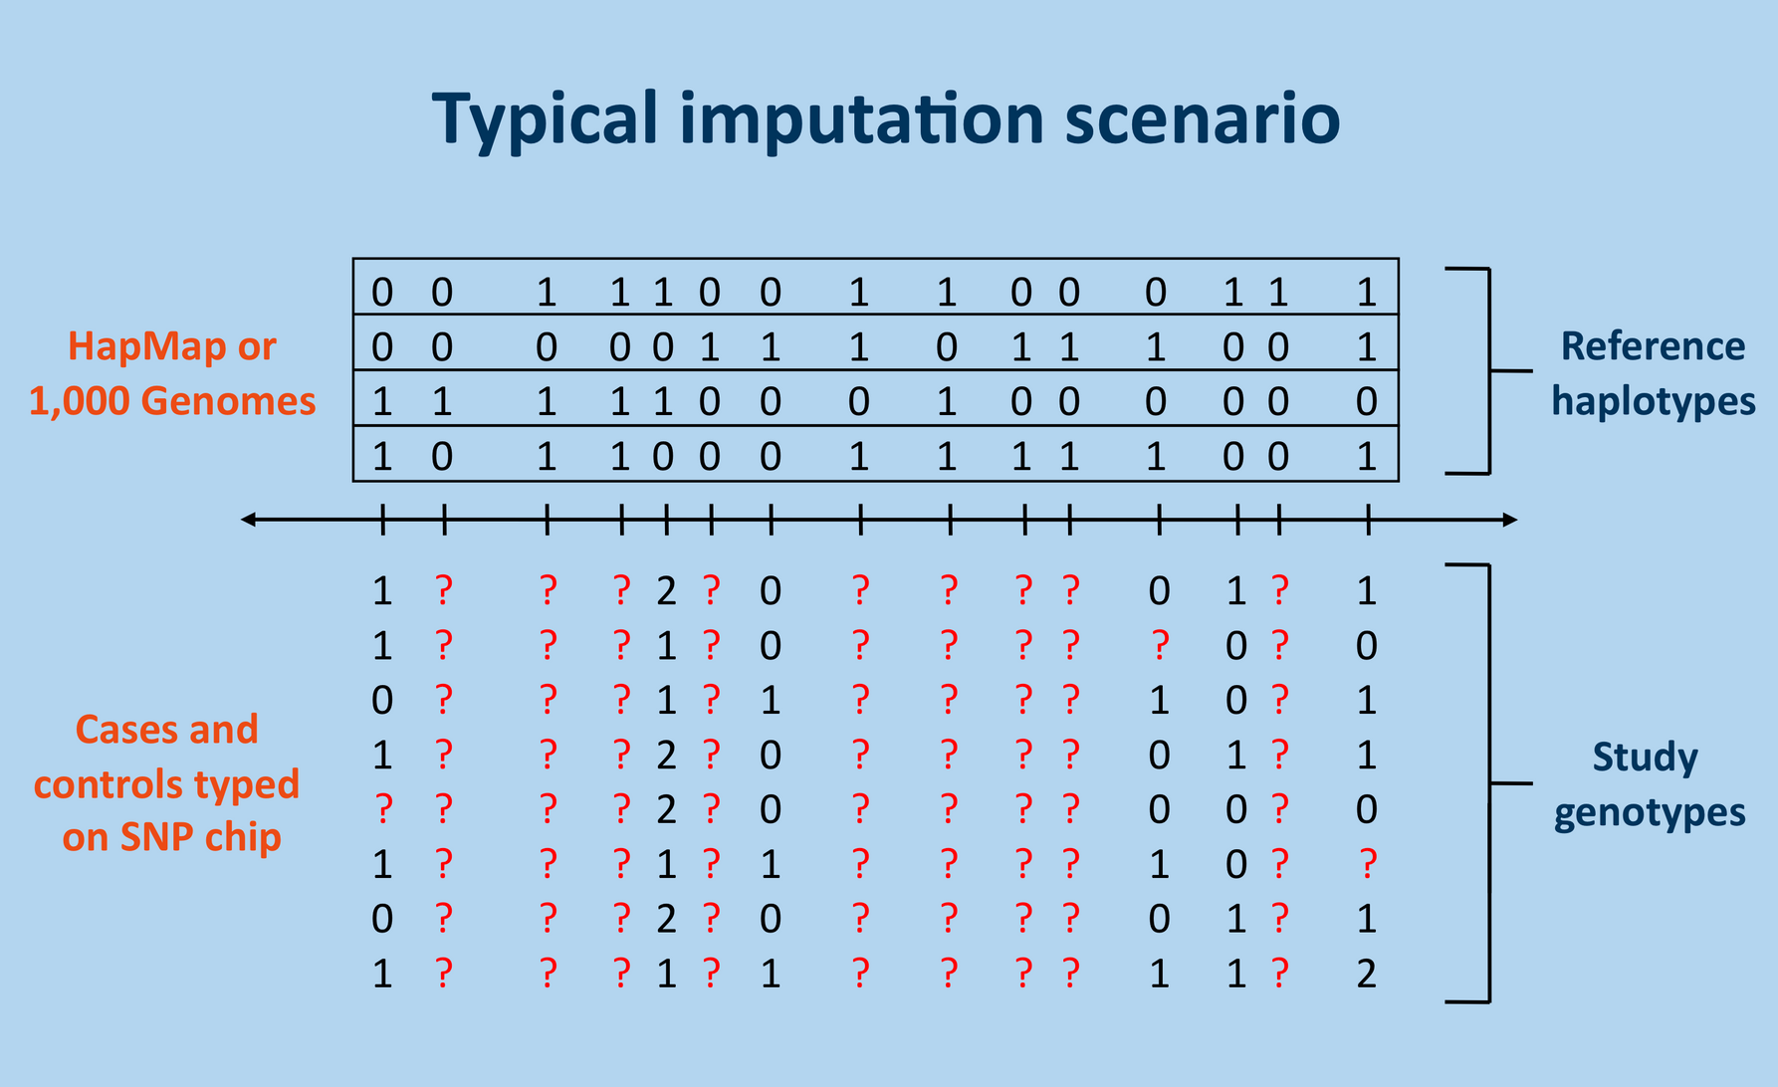
http://mathgen.stats.ox.ac.uk/impute/impute_v2.html

Slide 11
What is phasing

Slide 12


Slide 13


Why we need to do imputation

Slide 14
Cheap
Direct sequence a large population is still expensive
Increase power
The reference panel is more likely to contain the causal variant (or a better tag) than a lower density panel
Fine-mapping
Imputation provides a high-resolution overview of an association signal across a locus
Meta-analysis
Imputation allows different genotype panels to be combined up to the variants in the reference panel

Slide 15


Imputation Server
Michigan Imputation Server (human)
https://imputationserver.sph.umich.edu
Sanger Imputation Service (human)
https://imputation.sanger.ac.uk/
TOPMed Imputation Server (human)
https://imputation.biodatacatalyst.nhlbi.nih.gov
Animal-ImputeDB (animals)
http://gong_lab.hzau.edu.cn/Animal_ImputeDB#!/

Slide 16
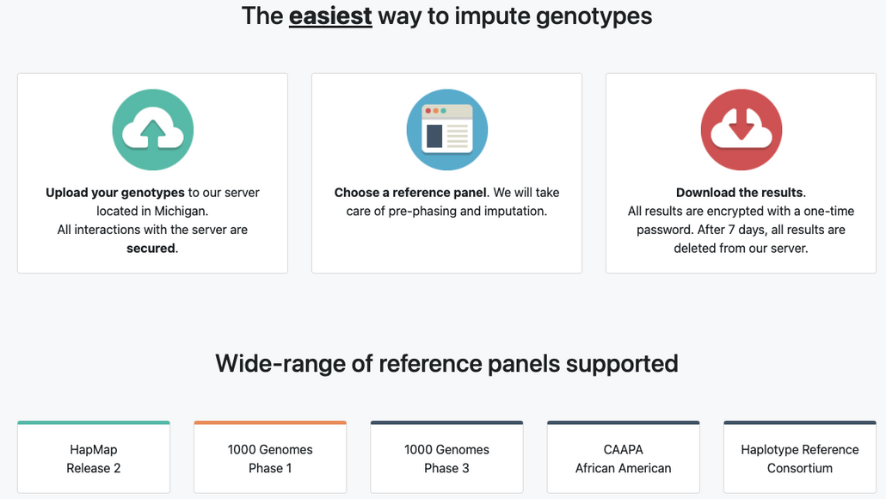
Pros & Cons (MIS)
Pros: User friendly, support both autosome and chrX
Cons: Hard to use own reference panel, can not handle large population (up to 110k), fixed software (eagle& minimac4), imputation quality, data security

Slide 17
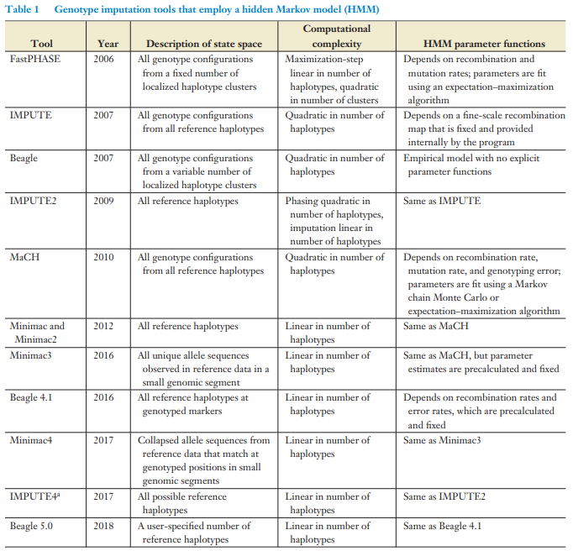
Annu. Rev. Genom. Hum. Genet. 2018. 19:73–96

Slide 18
Imputation software
Pros & Cons
Pros: flexible about reference, majority are free, easy to get imputation accuracy, more flexible in all aspects
Cons: might be slow, may need large memory, software may contain bugs, license problem, performance might vary based on dataset

Slide 19

Do you have questions so far?

Slide 20




How do I know if the imputation was done well

Slide 21




Parameters to evaluate imputation accuracy
Genotype concordance
Genotype correlation
Imputation Quality Score (IQS) (Lin et al (2010))
Dosage/Allelic R-square
Pearson correlation coefficient between true and imputed genotypes. Need to know the true status.
Genotype concordance is computed per locus as the percentage (or proportion) of alleles or genotypes that is imputed incorrectly. A closely related measure is the percentage of correctly imputed alleles or genotypes, which can simply be calculated as 100% minus the imputation error rate. Need to know the true status.
BEAGLE R2 approximates the squared correlation between the most likely genotype and the true unobserved allele dosage. IMPUTE2/Minimac3 INFO considers allele frequency as well as the observed and expected allele dosage. Neither of these need true genotypes.
It adjusts the concordance between imputed and genotyped SNPs for chance, however is not widely used in accuracy assessment.

Slide 22
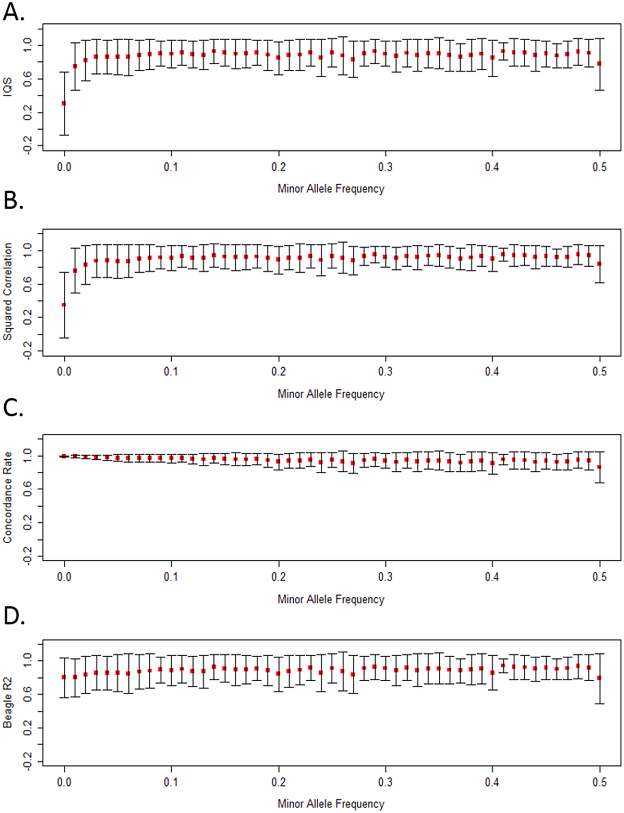
Why error rate is not recommended
Our results provide further evidence that concordance rate inflates accuracy estimates particularly for rare and low frequency variants. These observations highlight a need to account for chance agreement not only when assessing imputation accuracy, but also more broadly in other situations for which concordance is traditionally used to assess accuracy, such as checking genotype agreement across duplicate samples. Concordance rate will always produce a value greater than or equal to IQS due to their mathematical relationship (see Methods for proof).
Ramnarine, Shelina, et al. "When does choice of accuracy measure alter imputation accuracy assessments?." PloS one 10.10 (2015): e0137601.

Slide 23
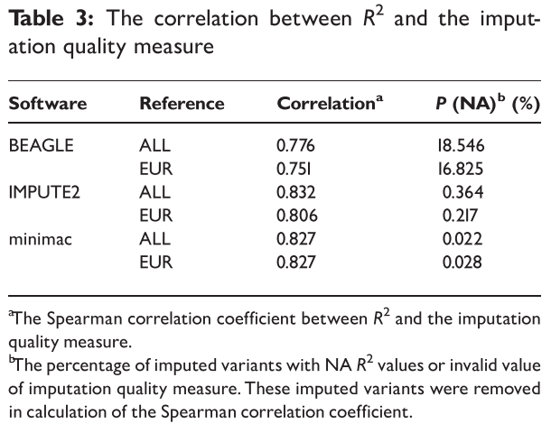
R-squared
Dosage R-squared and Allelic R-squared
The allelic R2 from BEAGLE is the squared correlation between the best-guess genotype and the allele dosage. The information metric from IMPUTE2 measures the relative statistical information about the population allele frequency. The minimac Rsq is the ratio of the observed variance of the allele dosage to the expected binomial variance at HWE. Despite differences in the calculation of these imputation quality measures (reviewed by Marchini and Howie [2]), they all range between 0 and 1, with larger values corresponding to higher imputation quality.
Liu, Qian, et al. "Systematic assessment of imputation performance using the 1000 Genomes reference panels." Briefings in bioinformatics 16.4 (2015): 549-562.

Slide 24
R-squared
Dosage R-squared and Allelic R-squared
We noticed that in this setting, the quality measure of BEAGLE is comparable with (or even slightly better than) the quality measures from the other two programs in removing poorly imputed variants from their corresponding imputation results.
...
Therefore, to achieve the highest accuracy, we recommend setting the imputation quality cutoff to small values for BEAGLE (e.g. <0.4), intermediate values for minimac (e.g. between 0.2 and 0.6) and large values for IMPUTE2 (e.g. between 0.6 and 0.9).
Liu, Qian, et al. "Systematic assessment of imputation performance using the 1000 Genomes reference panels." Briefings in bioinformatics 16.4 (2015): 549-562.

Slide 25
Factors influence imputation accuracy
Number of ancestors genotyped in the reference (Hickey et al., 2011; Huang et al., 2012a)
SNP density on the low and high panel (Mulder et al., 2012)
MAF of the imputed SNP (van Binsbergen etal., 2014)
Whether imputed SNP are located at the end of a chromosome or not (Badke et al., 2013; Cleveland and Hickey, 2013; Wellmann et al., 2013)
The number of individuals in the reference population (Zhang and Druet, 2010)
The relationship between imputed individuals and individuals genotyped at high density (Hickey et al., 2012)

Slide 26
Imputation to sequence
•Two groups of individuals
•Sequenced individuals: reference population
•Individuals genotyped on SNP array: target individuals / study population
•Steps:
•Step 1. Find polymorphisms in sequence data
•Step 2. Phase genotypes (eg Beagle) in sequenced individuals, create reference file
•Step 3. Generate the genotype file for all study animals for polymorphisms (SNP, Indels)
•Step 4. Impute all polymorphisms into individuals genotyped with SNP array

Slide 27
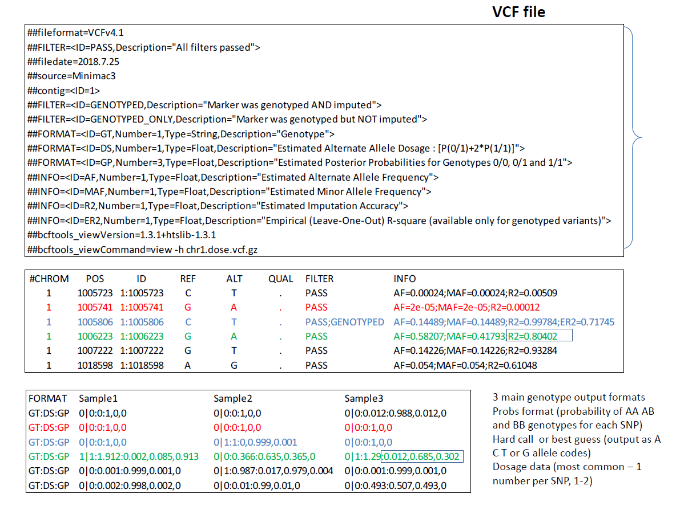

Slide 28
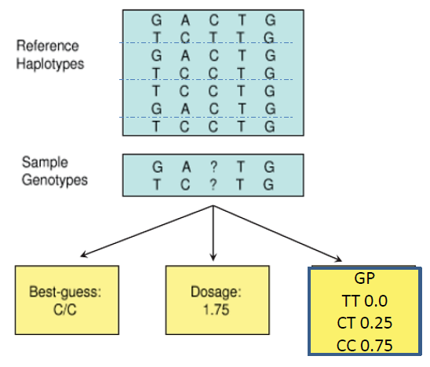

Slide 29
Post imputation QC
After imputation you need to check that it worked and the data look ok
•Things to check
•Plot r2 across each chromosome look to see where it drops off
•Plot MAF-reference MAF
•For each chromosome check N and % of SNPs:
•MAF <.5%
•With r2 0-0.3, 0.3-0.6,0.6-1
•If you have hard calls or probs data HWE P < 1E-6
•If you have families convert to hard calls and check for Mendelian errors

Slide 30
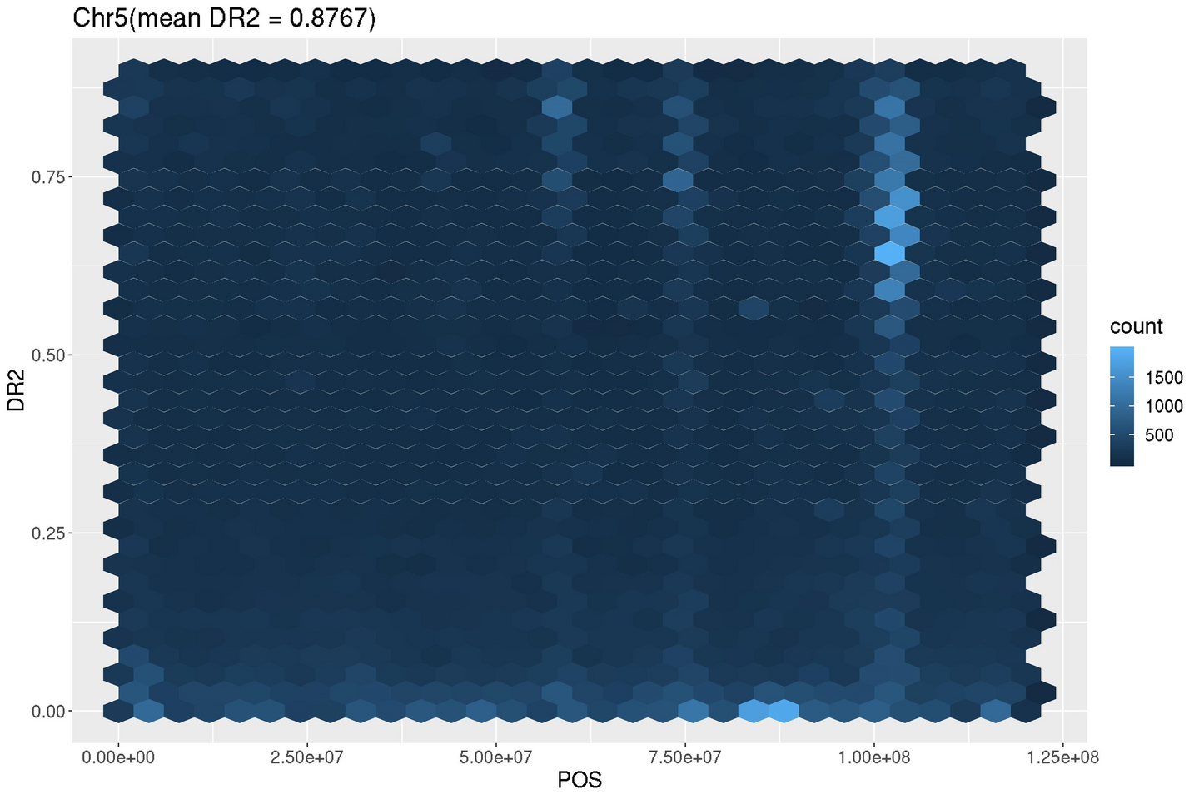
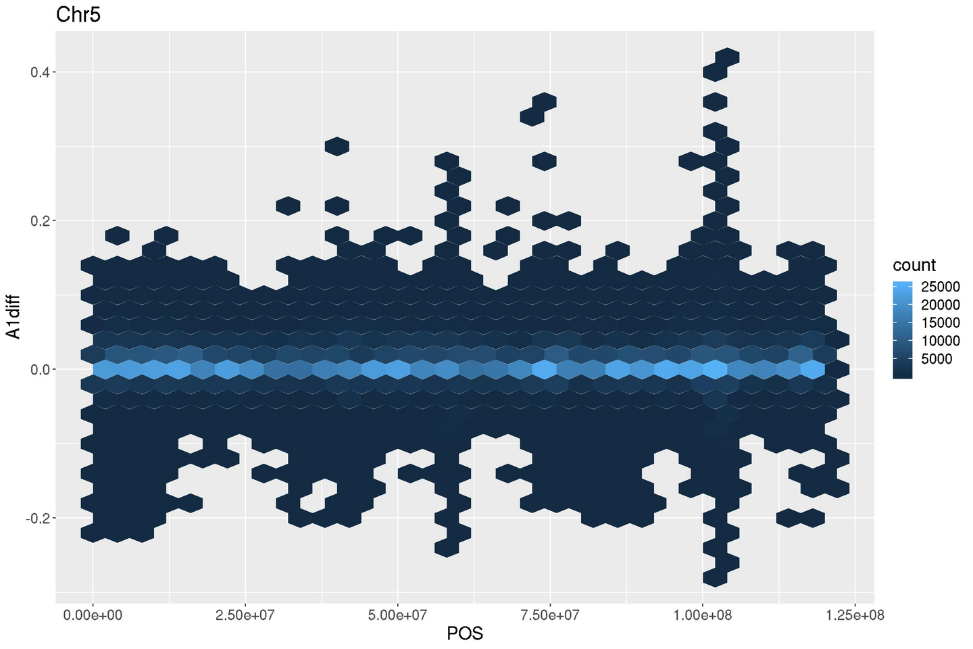

Slide 31


Take home message
•Genotype concordance is not an appropriate parameter for evaluating imputation performance
•Accuracy depends on size of reference, relationship to reference, marker density, map quality etc.
•Imputation to sequence possible, relatively low accuracies for rare alleles
•Use genotype probabilities from imputation in GWAS and genomic prediction

Slide 32
Practical for the afternoon
•Go through the imputation pipeline using 1000 Genome data (human)
•Understand the importance of quality control in imputation
•Have a look at how to use Beagle and Miminac3 for phasing and imputation and how the performance of imputation is evaluated

Slide 33

Thank you!
Yu Wang (Postdoctoral Scientist Quantitative Genetics & Genomics)
yu.wang@lic.co.nz

Slide 34






























Free Resources
Use these free recolorable icons and illustrations in your Canva design.

Slide 35










Free Illustration Resources
Use these free recolorable icons and illustrations in your Canva design.

